Slide 1
Introduction to AMQ Streams
Chatchai Kongmanee
Specialist Solution Architect
Red Hat, Thailand

Slide 2
Event
Driven
Architecture
Red Hat Integration Technical Overview

Slide 3
Introduction:
Events
EVENT-DRIVEN ARCHITECTURE

Slide 4

What is an event?
EVENT-DRIVEN ARCHITECTURE
Event an action or occurrence recognized by software, often originating asynchronously from the external environment, that may be handled by the software
Image: https://foto.wuestenigel.com/hand-ready-to-push-domino-pieces/
Notes:
So the event is just the change of the state
What’s important is the notification of the events

Slide 5



What is an event?
EVENT-DRIVEN ARCHITECTURE
Event
Command
Query
Immutable state and value of a particular entity, which occurred during operation among services.
Async form of Remote Procedure Call, contains instructions telling recipient what to do, may cause a change of state.
Similar to commands, queries expect a response returning the results, but do not cause any change in state.
Source: https://developers.redhat.com/topics/event-driven/
Notes:
Talk about the difference between events, commands and queries. Don’t mention CQRS (too much at this point)

Slide 6



Types of event consumption patterns
EVENT-DRIVEN ARCHITECTURE
Volatile
Durable
Replayable
The event needs to be disseminated to all consumers online at time of publication. Not persisted.
Events stored durably until read by all registered consumers. Traditional store-and-forward brokers.
Events stored durably for specific period of time or storage capacity. Consumers can move back and forth of the stream.
Source: https://developers.redhat.com/topics/event-driven/
Notes:
As events are generated in one of the Event-driven Architecture components and the notifications placed in the channel, the communication pattern used to share then defines also the nature of the messages. For the purpose of better understanding, we have classified events in 3 major types. This event types allow software architects to choose adequate event-driven architecture component implementations
Volatiles - room temperature - audience is not crucial in this type
Consumable needs to get feedback from consumers
Replayable - auditable information

Slide 7
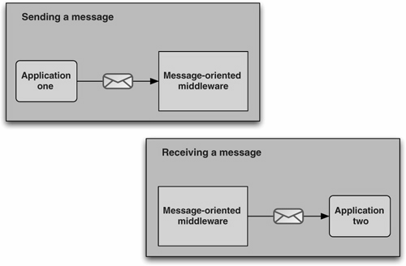
What is Event-Driven Architecture?
EVENT-DRIVEN ARCHITECTURE
Event-Driven Architecture (EDA) is a way of designing applications and services to respond to real-time information based on the sending and receiving of event notifications
Source: https://www.gartner.com/en/information-technology/glossary/eda-event-driven-architecture :
Image: ActiveMQ in Action https://www.manning.com/books/activemq-in-action
Notes:
EDA is of course often documented in sequence state diagrams like this one, showing how each actor responds to real time events from other actors.

Slide 8
Why Event-Driven Architecture or EDA?
EVENT-DRIVEN ARCHITECTURE
Mirrors the real world
Encapsulation
The real world is event-driven. Systems generate and respond to events in everyday life, e.g., the human central nervous system.
Microservices concepts have grown in popularity due to the ability for service teams to develop services in isolation. EDA means that service designers need not be aware of how events are consumed.
Reduced coupling
Fine-grained scaling
Traditional RPC-style service architecture results in tightly-bound services. Changes to the application flow typically require service code changes. EDA allows new functionality to be added by adding services that consume existing event streams.
Services can be independently scaled up and down to meet the event volume.
Near real-time latency
Customers increasingly expect a near real-time experience. Polling on APIs is a delicate trade-off between responsiveness and load. EDA allow apps to react in near real-time without compromise.
Source:https://developers.redhat.com/topics/event-driven/

Slide 9
How to choose the right implementation?
EVENT-DRIVEN ARCHITECTURE
EXAMPLES | BEST FIT PATTERNS | POSSIBLE PATTERNS | UNSUITABLE PATTERNS
Traditional messaging broker w/ Queuing & Pub/Sub Rich feature set inc. JMS 2.0 Message Brokers like Apache ActiveMQ Artemis | DURABLE EVENTS | VOLATILE EVENTS COMMAND QUERY | REPLAYABLE EVENTS
Message router 1:1 (anycast) and 1:many (multicast) Secure messaging backbone for hybrid cloud Message Routers like Apache Qpid Dispatch Router | COMMAND QUERY VOLATILE EVENTS |  | DURABLE EVENTS REPLAYABLE EVENTS
Enterprise distribution of Apache Kafka Simplified deployment on Kubernetes/OpenShift Like Kafka on Kubernetes based on Strimzi | REPLAYABLE EVENTS DURABLE EVENTS | COMMAND QUERY | VOLATILE EVENTS TRANSACTED/FILTERED EVENTS
Source: https://developers.redhat.com/topics/event-driven
Notes:
As events are generated in one of the Event-driven Architecture components and the notifications placed in the channel, the communication pattern used to share then defines also the nature of the messages. For the purpose of better understanding, we have classified events in 3 major types. This event types allow software architects to choose adequate event-driven architecture component implementations
Volatiles - room temperature - audience is not crucial in this type
Consumable needs to get feedback from consumers
Replayable - auditable information

Slide 10
Comparing Traditional Messaging and Event Streaming
EVENT-DRIVEN ARCHITECTURE
Messaging
Store-and-forward
Individual message exchanges (transactions, acknowledgment, error handling/DLQs), P2P/competing consumer support
Publish-subscribe support
Trade-offs
No replay support
Requires fast and/or highly available storage infrastructure
No ordering at scale
Event Streaming
Long-term persistence, semantic partitioning, large publisher/subscriber imbalances, replay and late-coming subscribers
Shared nothing data storage model
Repeatable ordering at scale
Trade-offs
No out of order acknowledge, weak support for request-response
Larger data footprint and extremely fast storage access
High initial entry cost
Source
Notes:
There are different kinds of treatments for events. Traditional messaging has been used for decades, and has characteristics that work well for transaction-based systems, where specific consumers can act on and acknowledge events as they occur, and producers can guarantee delivery and handle errors as they occur. Traditional messaging systems like Apache ActiveMQ or RabbitMQ form a set of message exchanges that can be individually configured for different delivery, queueing, and persistence behaviors.
Event streaming on the other hand produces an infinite stream of data from multiple sources, which can be acted upon by stream processing systems like Apache Kafka. These streams of data can also be persisted, and in addition can be “replayed” to new consumers or during a recovery from failure. This depends on the consumer having more “smarts” embedded in it to know where it should start reading from and which messages it has not yet received, but this also means that it can scale much better as the stream system is much simpler than traditional messaging systems.
Deciding which to use depends on the nature of the application, whether it requires transactionality, and the volume of events it is expected to handle. Stream processing can be beneficial, but also has additional complexity in the clients that use it.

Slide 11
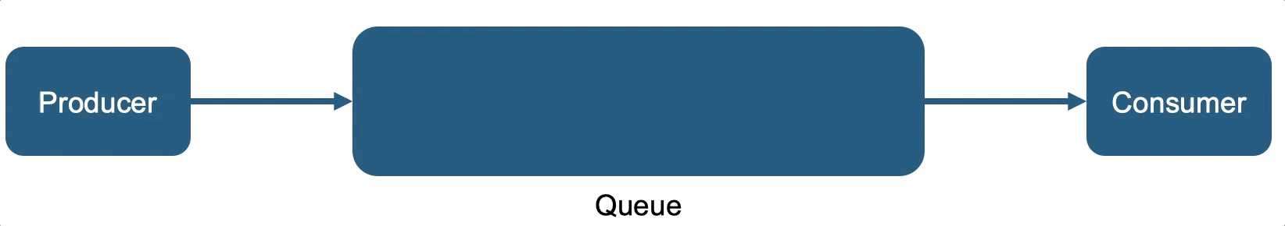
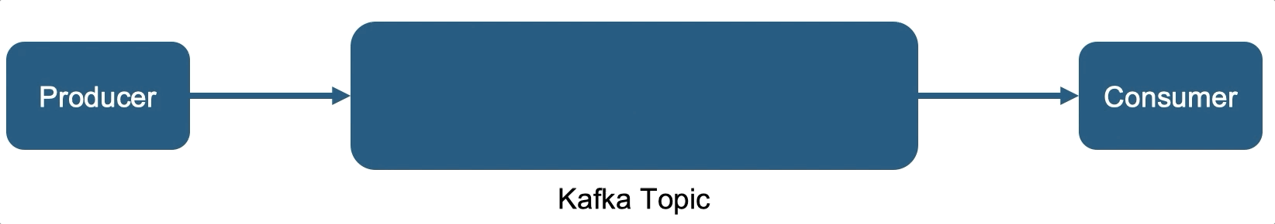
Red Hat Messaging System
AMQ Broker (Traditional)
AMQ Stream (Streaming)
‹#›

Slide 12







Event-driven architecture use cases
EVENT-DRIVEN ARCHITECTURE
Reactive notification
Behavior capture
Cache store
Complex event processing
Command query responsibility segregation (CQRS)
Streaming between data centers
Auditing
Source:
Notes:
Reactive notification
EDA allows events to quickly reach the targeted service and systems to react upon changes in state. These changes can be pushed to any AI system or can be bubbled up to other applications. Organizations can quickly respond to incidents, preempt potential issues, identify trends, and provide better services to customers.
Command query responsibility segregation (CQRS)
CQRS separates the input/update and query services with different access interfaces. Event driven architecture is an ideal approach to implement CQRS, as you can easily separate the query and result models into different channels. Caching can be introduced to speed up the read/output effort.
Behavior capture
Using the large amounts of data that organizations capture, business behavior can be extracted and tracked to predict potential future behavior, informing strategy and planning.
Auditing
All the changes of state in a system can be stored, at every step,inlog files. Change logs provide a valid capability for auditors to trace system changes at any point in time.
Complex event processing
In this use case, multiple and/or complex events combined in a certain business criteria can trigger a business process or decision.
Cache store
In this scenario, the logging of events in an in-memory cache can become a temporary data store for services to retrieve the latest state without needing to access the actual backend data store.
Streaming between data centers
Large enterprises often have multiple clusters of clouds across various geographies for high-availability, redundancy, backup or disaster recovery. Events can be broadcast across multiple geographies to allow instant inquiries, and make real-time decisions.

Slide 13


Microservices Async Communication
EVENT-DRIVEN ARCHITECTURE
Foundation for event-driven microservices
High availability: No dependency on other services
Autonomy in services with independent evolution
Source:

Slide 14
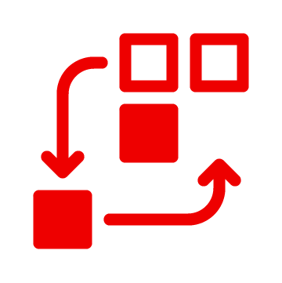

Request-reply & Event-driven
EVENT-DRIVEN ARCHITECTURE
Synchronous & ephemeral
Low composability
Simplified model
Low tolerance to failure
Best practices evolved as REST
Asynchronous and persistent Decoupled
Highly composable
Complex model
High tolerance to failure
Best practices are still evolving
Source:

Slide 15
Thinking about event-driven architecture
EVENT-DRIVEN ARCHITECTURE
Events
Apps
Events
Microservices
Apps
LOBs
Regions
Events
Microservices
Lines of Business
Events
Regions
System and data-centric
Events are designed to respond to ad-hoc connectivity needs
Event-centric
Events are first class citizens that describe the interactions in the enterprise
APAC
Source
Notes:
To truly gain benefits of event-driven, one must rethink things - and re-cast their architectures in terms of events, so that instead of using ad-hoc events when needed, events become the language in which an application’s behavior is expressed, and describe interactions of the system. This can then be used to design an appropriate software architecture and components to handle those events.

Slide 16

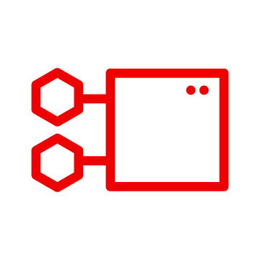
Connect loosely-coupled microservices
EVENT-DRIVEN ARCHITECTURE
Remain agile with event-centric microservice architecture
Connect microservices and stay agile
Publish events to and event bus or messaging broker and decouple the data from the event-consuming services
Meet event volumes by independently scaling up and down your microservices
Avoid hard-coding integrations and connections between microservices applications
Notes:
This decoupled nature of event handling is at the heart of event-driven microservices.
Event-driven microservices pass messages through messaging middleware to communicate amongst the services, thereby decoupling the components and allowing events to be observed, recorded, and acted upon. The messaging backend provides the ability to do advanced distributed actions like flow control, delivery guarantees, and persistence for high availability.

Slide 17





Event Stream Processing Use Cases and Applications
EVENT-DRIVEN ARCHITECTURE
Web Site Activity Tracker
Metrics
Log Aggregation
Rebuild user activity tracking pipeline as a set of real-time publish-subscribe feeds.
Aggregation of statistics from distributed applications to produce centralized feeds of operational data.
Centralized collection of log files in a highly-available store, enabling real-time streaming access to log activity.
Stream Processing
Data Integration
Enables continuous, real-time applications built to react to, process, or transform streams.
Captures streams of events or data changes and feeds these to other data systems.
Source: https://kafka.apache.org/uses

Slide 18




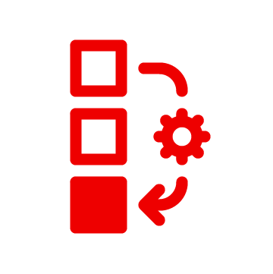
Streaming Data Processing
EVENT-DRIVEN ARCHITECTURE
Data processing from replayable streams
Stateless and Stateful processing
Reading data from multiple streams
Source:
Notes:
Reactive notification
EDA allows events to quickly reach the targeted service and systems to react upon changes in state. These changes can be pushed to any AI system or can be bubbled up to other applications. Organizations can quickly respond to incidents, preempt potential issues, identify trends, and provide better services to customers.
Command query responsibility segregation (CQRS)
CQRS separates the input/update and query services with different access interfaces. Event driven architecture is an ideal approach to implement CQRS, as you can easily separate the query and result models into different channels. Caching can be introduced to speed up the read/output effort.
Behavior capture
Using the large amounts of data that organizations capture, business behavior can be extracted and tracked to predict potential future behavior, informing strategy and planning.
Auditing
All the changes of state in a system can be stored, at every step,inlog files. Change logs provide a valid capability for auditors to trace system changes at any point in time.
Complex event processing
In this use case, multiple and/or complex events combined in a certain business criteria can trigger a business process or decision.
Cache store
In this scenario, the logging of events in an in-memory cache can become a temporary data store for services to retrieve the latest state without needing to access the actual backend data store.
Streaming between data centers
Large enterprises often have multiple clusters of clouds across various geographies for high-availability, redundancy, backup or disaster recovery. Events can be broadcast across multiple geographies to allow instant inquiries, and make real-time decisions.

Slide 19
Apache Kafka

Slide 20

What is Apache Kafka?
Developed at LinkedIn back in 2010, open sourced in 2011
Designed to be fast, scalable, durable and available
Distributed by nature
Data partitioning (sharding)
High throughput / low latency
Ability to handle huge number of consumers
Ecosystem rather than a single project

Slide 21
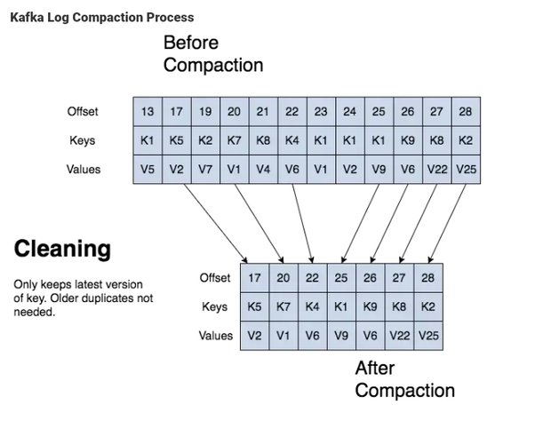
Scalability and Performance
Designed for horizontal scalability
Scaling has minimal impact on throughput and latency
Adding nodes to running cluster is easy
Message ordering guarantee
Messages are written to disk in the same order as received by the broker
Messages are read from disk from the requested offset
Kafka protocol makes sure that one consumer can read only one partition
Note ...
Order is guaranteed only within a single partition!
No synchronization between producers!
Message rewind / replay
Limited only by available disk space
Allows to reconstruct application state by replaying the messages
Combined with compacted topics allows to use Kafka as key-value store
Why should you use Kafka
Notes:
Cluster sizes from few brokers up to 1000s of brokers
3 nodes usually seen as minimum for production (HA, message durability)
Amount of stored messages has no impact on performance
Amount of stored messages has no impact on performance

Slide 22

Apache Kafka ecosystem
Kafka Core
Broker
Producer API, Consumer API, Admin API
Management tools
Kafka Connect
Kafka Streams API
Mirror Maker / Mirror Maker 2
3rd party tools, integrations, connectors, ...
Mirror Maker
Consumer API
Connect
Producer API
3rd party tools
Streams API

Slide 23

Apache Kafka
Kafka Broker
Responsible for hosting topics and delivering messages
One or more brokers run in a cluster
ZooKeeper ensemble is required to bootstrap the cluster
Kafka Producers and Consumers
Java-based clients for sending and receiving messages
Kafka Admin tools
Java- and Scala- based tools for managing Kafka brokers
Managing topics, ACLs, monitoring etc.
Tools
Clients

Slide 24
Kafka Connect
Wraps around the Consumer and Producer APIs
Framework for transferring data between Kafka and other data systems
Facilitate data conversion, scaling, load balancing, fault tolerance, …
Connector plugins are deployed into Kafka connect
Well defined API for creating new connectors (with Sink/Source)
Apache Kafka itself includes only FileSink and FileSource plugins
Many additional plugins are available outside of Apache Kafka project
External System
Kafka Connect: Source Connector
Kafka Connect: Sink Connector
External System

Slide 25

Kafka Connect + Kafka Streams API
EVENT-DRIVEN ARCHITECTURE
Kafka Connect
Kafka
Kafka Connect
Source Connector
Topic
Sink Connector
Topic
Topic
Topic
Topic
Topic
Application
Streams API
Processing
Processing
Other Systems
Other System
Source
Notes:
For kafka connect , kafka connect is a tool for streaming data between kafka and other data systems such as database, file,
With no coding, you can config and start kafka connect and connector for send data to kafka or retrieve data from kafka to another data system
In some case, if you want to processing data in kafka before send to destination consumer, you can used streams api for processing data in topic such as aggregate data from 2 topic before send to consumer.
Ok, next slide we will talk about amq streams

Slide 26
Mirror Maker
Synchronizing messages between two or more Kafka clusters
Kafka is latency sensitive
Zookeeper require low latency to maintain a quorum
Kafka is less latency sensitive, but replications and reliable producers will be slow with high latency networks
As a result, geo-distributed Kafka clusters do not work well
Usual solution is to create local clusters and mirror data between them
Mirroring with Kafka is always asynchronous!

Slide 27
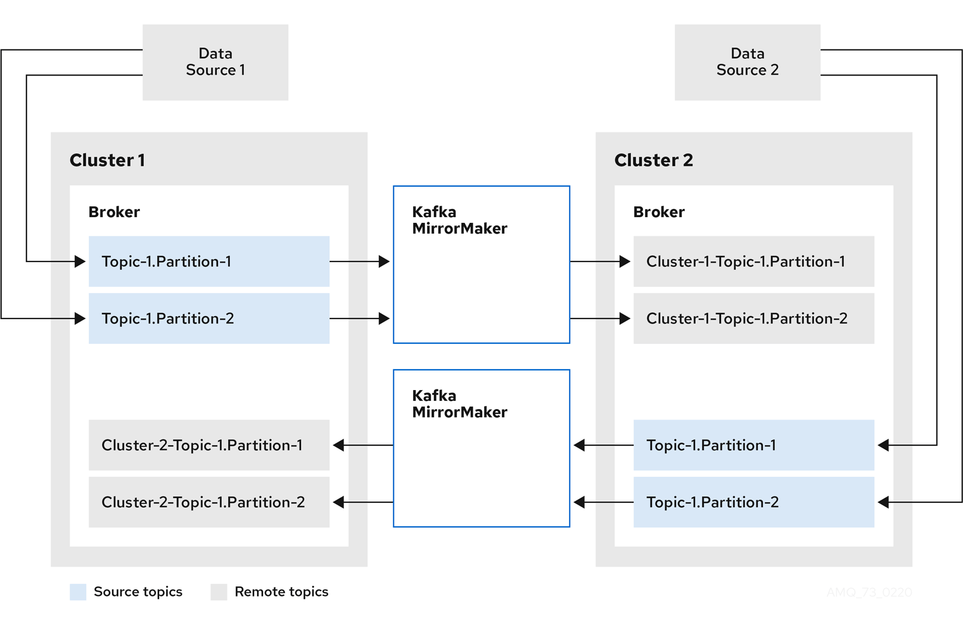
Kafka Mirror Maker 2
New in Apache Kafka 2.4
Builds on top of Kafka Connect
New features in Mirror Maker 2
Support for multiple clusters
Offset synchronization
Topic configuration synchronization

Slide 28
3rd party components
Clients for other languages
REST Proxy for bridging between HTTP and Kafka
Schema Registry
Cluster Balancers
Management and Monitoring consoles
Kafka Connect plugins
Kafka can be used with many other projects (e.g. Apache Spark, Apache Flink, Apache Storm)

Slide 29
Red Hat AMQ Streams

Slide 30
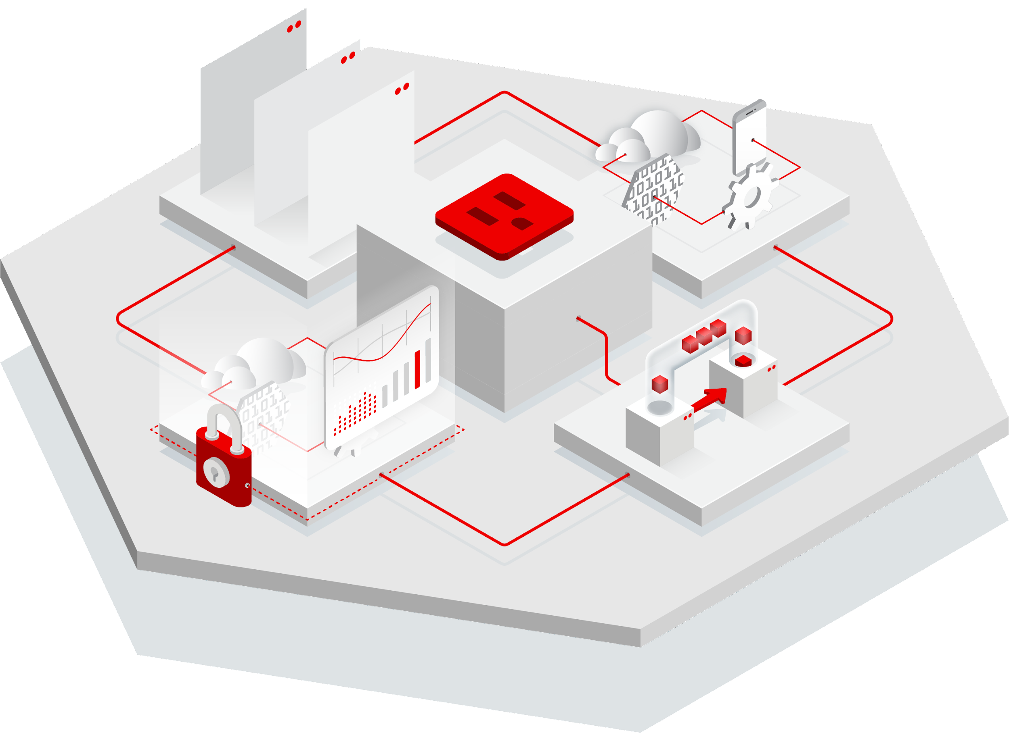
Red Hat Integration
DEVELOPING CONTAINER & CLOUD-NATIVE APPLICATIONS
Data Integration
Enterprise Integration
Change Data Capture with Debezium
Comprehensive connectors
Microservices orchestration
Data Transformation
Low-code iPaaS
Kubernetes connectivity with Camel K
API Management
Events & Messaging
API Manager
API Gateway
Istio Service Mesh Adapter
JMS Message Broker
Wide Area Routing
Data Streaming with Apache Kafka
Tooling & Metadata
Service Registry
API Designer
Integration Operator
Source
Notes:
amq steams is part of the red hat integration package, red hat integration is an application package for integration solutions.
red hat integration consists of several software such as integration framework that is red hat fuse, messaging solution
such as amq broker or amq streams, api management for gateway services, tools such as service registry, api designer and
Change data capture with debezium kafka connector for database

Slide 31
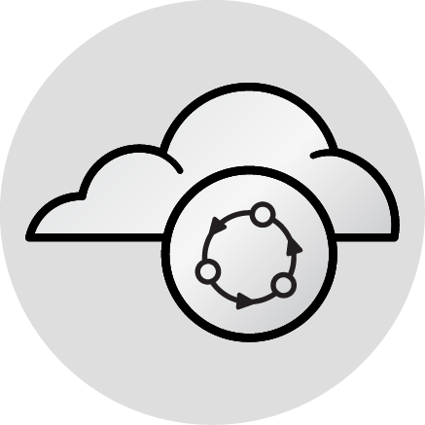

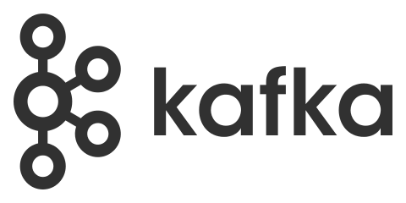
AMQ Streams
Zookeeper (for Kafka only)
HTTP Proxy
Broker
Connect
Producer API
Mirror Maker
Consumer API
Streams API
Operators
Admin API
Notes:
AMQ Streams simplifies the process of running Apache Kafka in an OpenShift cluster and RHEL.
It have capabilities and component architecture of Kafka can deliver, all of kafka ecosystem components plus add on component such as Operator for openshift deployment,
HTTP Proxy for bridge REST API to Kafka, kafka exporter for monitor topic/partition and lag of consumer , and cruise control for automatic rebalance partition
Plus support service from red hat,

Slide 32
AMQ Streams
Two versions: for RHEL and OCP
RHEL
Suitable for VMs or bare metal on Red Hat Enterprise Linux
Zookeeper, Apache Kafka, HTTP Proxy, Cruise Control
No special configuration or management tooling
Just a ZIP download or Automate with Ansible
OCP
Power of operators
VMs, bare metal, private clouds, public clouds
Notes:
Now Amq streams support 2 deployment environments
For RHEL on Virtualization or Bare Metal and on OpenShift Container Platform
For RHEL, it suitable for vms or bare metal on Red hat enterprise linux,
It just a zip download from red hat , you can extract and config to start use amq streams or automate deployment it with ansible
It no special configuration and management tooling
For OCP we Operator for manage all of deployment, kafka, zookeeper, topic can deploy with operator by yaml file
With ocp you can deploy amq streams on all infrastructure, vms, bare metal , private and public clouds

Slide 33

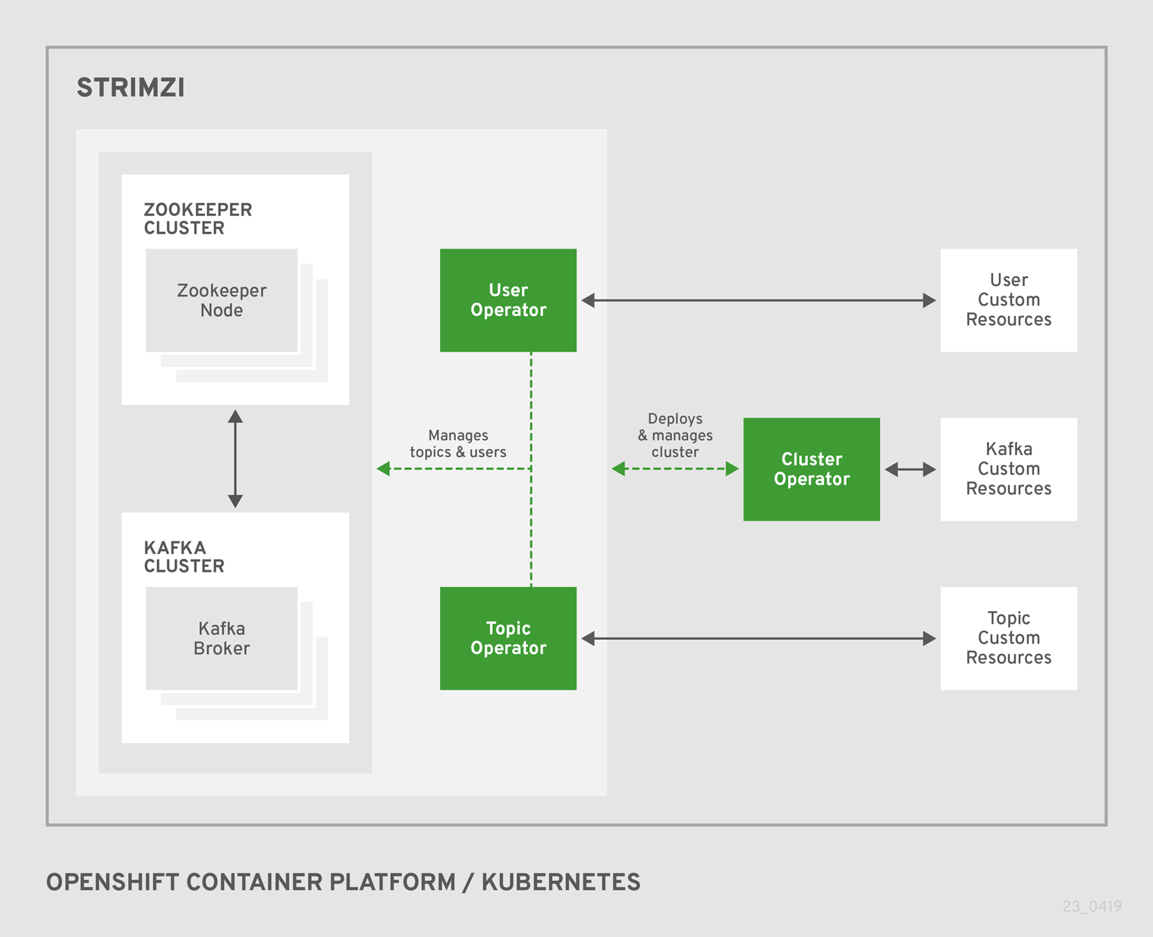



Strimzi
Running Apache Kafka on Kubernetes
Started by Red Hat in 2018
Used as a bases for AMQ Streams on OCP
Web site: http://strimzi.io/
GitHub: https://github.com/strimzi
Twitter: @strimziio
Notes:
For amq streams on openshift based on open source strimzi, it started by red hat in 2018
For create operator of kafka on openshift

Slide 34


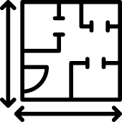


Deploy & Manage with Operator
Zookeeper cluster
Topic & User operators
Kafka Custom Resource
Cluster operator
Kafka cluster
Cruise Control
Kafka Exporter
Notes:
With operator on openshift, you can define cluster configuration in yaml file and you cluster operator and topic & user operator for create and maintain you kafka ecosystem

Slide 35
HTTP Bridge
Allows to producer and consumer Kafka messages using HTTP protocol / REST API
Red Hat Consulting - AMQ Streams
APPLICATION
REST API
KAFKA BRIDGE
Notes:
By default kafka and amq streams provide only java client api for producer and consumer.
If you need client api for another programming language , you need 3rd party library to implement of use Rest API from HTTP Bridge component
Http bridge is a add on component for allow producer and consumer used rest api with kafka
Client can call to http bridge with normal http protocol for send/receive data from kafka

Slide 36
Cruise-Control (Rebalance Broker base on Goal/Metric)
Component for monitoring cluster workload, rebalancing a cluster based on predefined constraints, and detecting and fixing anomalies.
Add cruise-control metric reporter to kafka broker
Start cruise-control service for serve rebalance request (REST API)
Reassign
Metrics
Metrics
Metrics
Metrics
Rest API
Cruise-Control
Spec vm: 2 cores, 16 GB
Notes:
Another add on component is cruise control.
Once you've been using kafka for a while, you may need to add or remove a broker or maintain a node or vm. You may need to reassign the partition.
By default if you want to rebalancing partition in kafka cluster, you must manual config and manual call reassignment with kafka-reassign tool
With Cruise control is a Component for monitoring cluster workload and rebalancing partition in cluster.
Cruise control use metric from broker workload and predefine constraint such as capacity on broker node to reassign topic/partition for balance broker workload

Slide 37
AMQ Streams
KAFKA SERVER BINARIES
Operating System | Architecture | JVM
RHEL 7 | x86_64 | OpenJDK 8 and 11
RHEL 8 | x86_64 | OpenJDK 8 and 11
KAFKA JAVA CLIENTS
Operating System | Architecture | JVM
RHEL 7 | x86_64 | OpenJDK, Oracle JDK, IBM JDK 8 and 11
RHEL 8 | x86_64 | OpenJDK, Oracle JDK, IBM JDK 8 and 11
Windows Server 2012 R2 | x86_64 | Oracle JDK 8 and 11
Notes:
For amq streams on rhel, now support rhel 7 and rhel 8 with openjdk 8 and 11
For client support rhel 7, rhel 8 and windows server with jdk 8 and 11

Slide 38
AMQ Streams
Supported OCP versions
OCP 4.8
Storage requirements
Requires block storage
NFS does not work well with Kafka and is not supported
Ideally XFS or ext4 filesystems
Notes:
For openshift container platform deployment, We support since Version 4.6 or later.
For storage requirements , amq streams requires block storage, nfs not supported , and recommend to use XFS or ext4 filesystems

Slide 39
AMQ Streams
Latest release (2.2 *LTS)
Kafka 3.2.3 (with zookeeper, not support kraft mode in production)
Strimzi 0.29
*The LTS version will be supported for 1 year and 6 months from the time of the minor GA release date.
Notes:
Latest release of amq streams is version 2.1
It base on kafka 3.1 with zookeeper version, for kraft mode it not ready for production now.
For ocp base on srtimzi 0.28
In version 2.1 add more feature such as
It deprecated mirror maker 1, change to mirror maker 2 , mirror maker 2 support replicate topic, message and offset and use kafka connect framework
Improve tls configuration, operator metrics, reloading log config without restarts, http bridge and cruise control

Slide 40
Red Hat Integration
Additional components are part of Red Hat Integration
Debezium (Connector for Kafka Connect for CDC)
Apicurio Service Registry
Camel Kafka connectors for Kafka Connect
Fuse (Kafka component)
Notes:
And with amq streams is a part of Red Hat Integration, if you subscription with red hat integration
You can use another product in red hat integration for support and extend you kafka cluster such as
Debezium for create change data capture event from database system such as mysql, postgresql, mongodb, sql server, db2 (except oracle) to amq streams
Service registry for keep/maintain schema of your application such as keep schema of message in kafka topic for validate before send and receive from kafka
Camel kafka connectors for implement kafka connect to or from your existing system
And kafka component of Fuse for implement integration service

Slide 41

Apache Kafka (Community)
EVENT-DRIVEN ARCHITECTURE
Zookeeper Cluster
Zookeeper Cluster
Manages
Zookeeper Cluster
Kafka Cluster
Java Clients / Kafka Streams
(Inc Quarkus)
Kafka Cluster
Java Clients / Kafka Streams
Converts
Consumes / Produces
Kafka Connect Cluster
Kafka Connect Cluster
Replicates
Connects
Other Connectors
Mirror Maker 2
Notes:
The Apache Kafka project under the Apache Foundation includes a limited set of components. These components are colored in dark grey. Customers can also get access to other clients and connectors that are open source.

Slide 42

EVENT-DRIVEN ARCHITECTURE
Entity Operator
(Topic, User)
Cluster Operator
Deploys
Manages
Single Sign On
Zookeeper Cluster
Zookeeper Cluster
Manages
Zookeeper Cluster
Authenticates
Cruise Control
Manages
HTTP Bridge
Kafka Cluster
Java Clients / Kafka Streams
(Inc Quarkus)
Kafka Cluster
Java Clients / Kafka Streams
Consumes / Produces
Converts
Consumes / Produces
Kafka Connect Cluster
Kafka Connect Cluster
Validates
Replicates
Connects
Other Connectors
Mirror Maker 2
Red Hat Service & Support
Notes:
Red Hat AMQ includes an enterprise version of the Apache Kafka project with all the included components. It also adds additional components developed to enhance the ecosystem, similar as other providers that have and open core model. In the case of Red Hat, this components are 100% open source. Still, customers can bring their own connectors and clients and use them with Red Hat software, but without Red Hat support

Slide 43

EVENT-DRIVEN ARCHITECTURE
Entity Operator
(Topic, User)
API Management
Cluster Operator
Deploys
Manages
Single Sign On
Zookeeper Cluster
Zookeeper Cluster
Manages
Secures
Zookeeper Cluster
Authenticates
Cruise Control
Manages
HTTP Bridge
Consumes / Produces
Kafka Cluster
Java Clients / Kafka Streams
(Inc Quarkus)
Kafka Cluster
Java Clients / Kafka Streams
(Inc Quarkus)
Validates
Debezium Connectors
Connects
Converts
Consumes / Produces
Camel K & Kamelets / Camel Extensions for Quarkus
Kafka Connect Cluster
Service Registry
Captures
Kafka Connect Cluster
Validates
Replicates
Red Hat App Foundations
Connects
Camel Kafka Connectors
Mirror Maker 2
Red Hat Service & Support
Red Hat AMQ Streams
Debezium Connectors
Other Connectors
Apache Kafka
Notes:
Red Hat Integration provides the more complete solution for customers implementing an event processing platform. Red Hat Integration adds the power of the Apache Camel components under the Camel Kafka Connect subproject to increase the amount of Kafka Connect connectors to over 340. It also enables the implementation of patterns like change data capture with the support of the popular debezium connectors for Apache Kafka. Finally, it allows you to have a seamlessly experience with you APIs through the inclusion of 3scale API management and the service registry to keep track of contracts and artifacts like OpenAPIs, AsynAPIs and Kafka schemas for Avro, JSON Schema and Google Protocol Buffers.

Slide 44
Thank you
AMQ Streams Enablement training 2020

Slide 45
Lab Information
GitHub : https://github.com/chatapazar/amq-streams-2022
GitBook : https://chatapazar.gitbook.io/amq-streams-training-2022/
Lab Info : https://bit.ly/amq-streams-2022-labs

Slide 46
Lab Time!
Lab 1 : Setup Red Hat AMQ Streams Lab
Lab 2: Introduction to Red Hat AMQ Streams

